Slide 1
NOVOSIBIRSK
STATE
UNIVERSITY
Introduction to
Machine Learning
Ahsan Shakoor
Machine Learning
2026
Novosibirsk State University

Slide 2

Course Overview
12 classes with theory, labs and a final project
01
Introduction to machine learning
07
k-NN & distance-based learning
02
Linear & nonlinear regression
08
Support vector machines
03
Logistic regression & neural nets
09
Clustering methods
04
Decision trees
10
Dimensionality reduction
05
Random forests & bagging
11
Recommendation systems
06
Boosting methods
12
Final presentations & course review

Slide 3

You drive to campus every day, but winter snow
often changes how long the trip takes.
2

Slide 4

Can you predict how long your next trip will take
if the snow is 40 mm deep?
Snow (mm) | Time (minutes)
0 | 10
5 | 11
10 | 12
15 | 13
20 | 14
40 | ?
3

Slide 5

You are developing a university app that tracks each student’s
study hours to help identify those at risk of failing.
4

Slide 6

Can you use this data to predict whether a student
will pass or fail the exam?
Study hours | Attendance (%) | Pass/Fail
27 | 45 | F
30 | 65 | P
23 | 80 | P
19 | 70 | P
25 | 50 | F
29 | 49 | ?
5

Slide 7

You own a fruit shop in the Главный Рынок and want to organize
your display so that similar fruits are placed close together,
so that you can serve your customers better.
6

Slide 8

Can you group the fruits into natural clusters to make it easier
for customers to choose and improve your sales?
Fruit | Color | Sweetness
Apple | Red | 7
Pear | Green | 7
Banana | Yellow | 9
Lemon | Yellow | 1
Watermelon | Green | 9
Avocado | Green | 3
7

Slide 9

ML Algorithm
An algorithm is a step-by-step set of instructions that tells
a computer how to solve a problem or complete a task.
A machine learning algorithm learns patterns from data
during training and uses them to make predictions
or decisions on new inputs.
8

Slide 10

Data preparation
Clean, explore, and understand data
Visualize data
What you’ll learn
Work with ML algorithms
Theory
Practice with scikit-learn
Evaluation
Test and compare
Improve models
9

Slide 11

How to pass
Lecture sessions and practical labs
Assignments, midterm, final project, and final exam
Course details and grading:
github.com/Ahsan-ShakoorK/NSU_ML
10

Slide 12
Get to
know
Machine
Learning
11

Slide 13
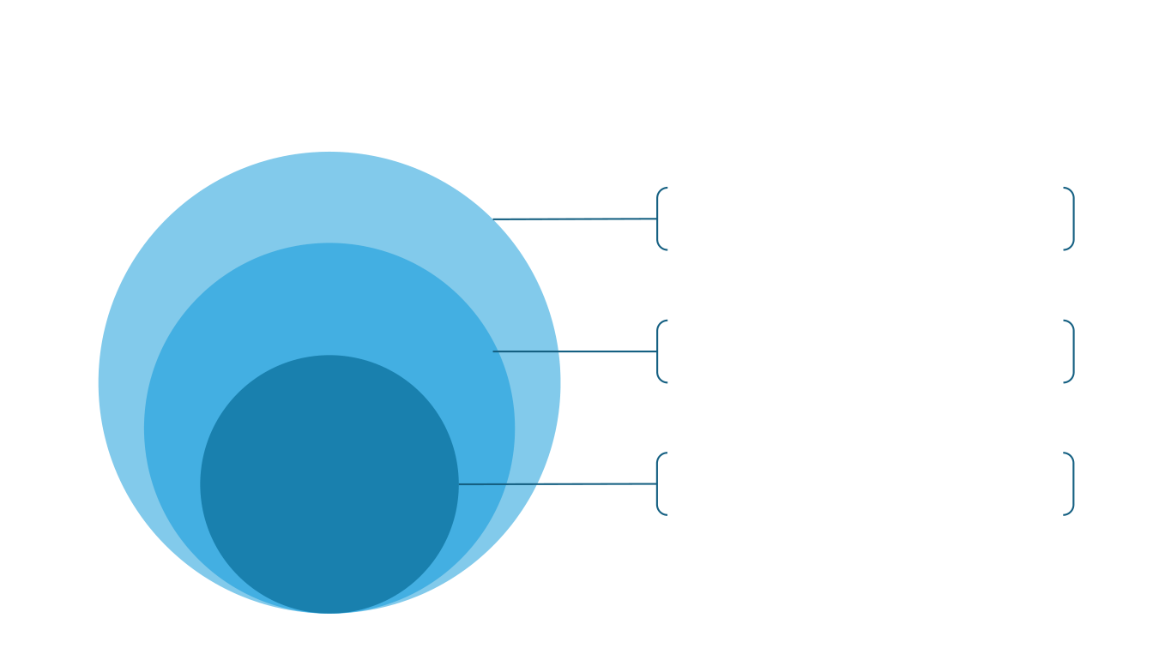
What is machine learning?
Artificial Intelligence
The broad field of creating systems that mimic
human intelligence to perform tasks
autonomously
Machine Learning
A subset of AI that learns patterns from data
during training, rather than requiring an explicit
rule for each individual prediction
A specialized area of ML that uses neural
Deep Learning
networks with multiple layers to model complex
patterns.
12

Slide 14
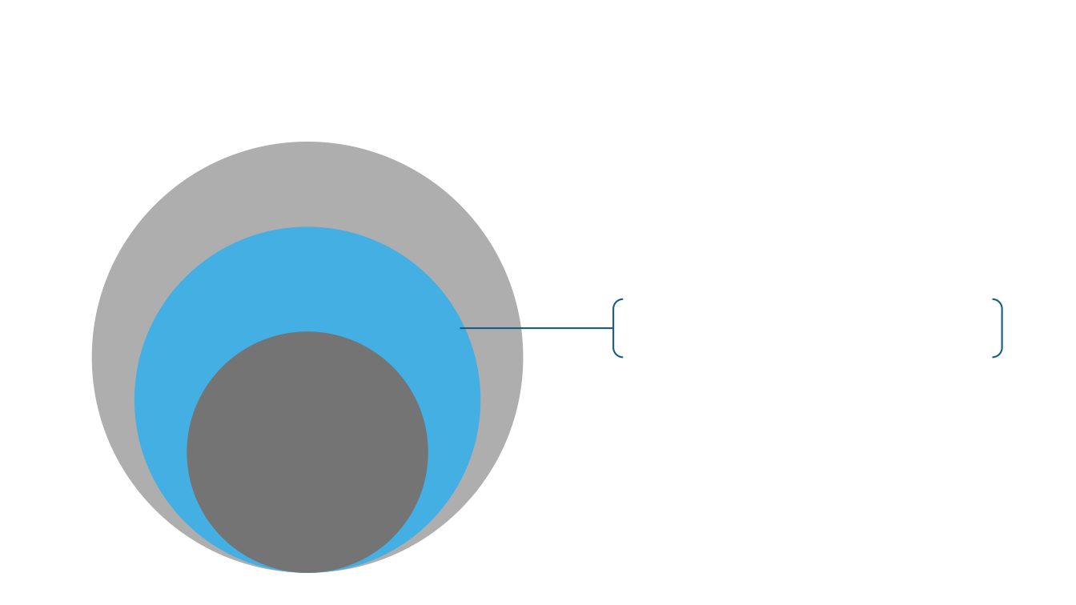
What is machine learning?
Machine Learning
A subset of AI that learns patterns from data
during training, rather than requiring an explicit
rule for each individual prediction
13

Slide 15
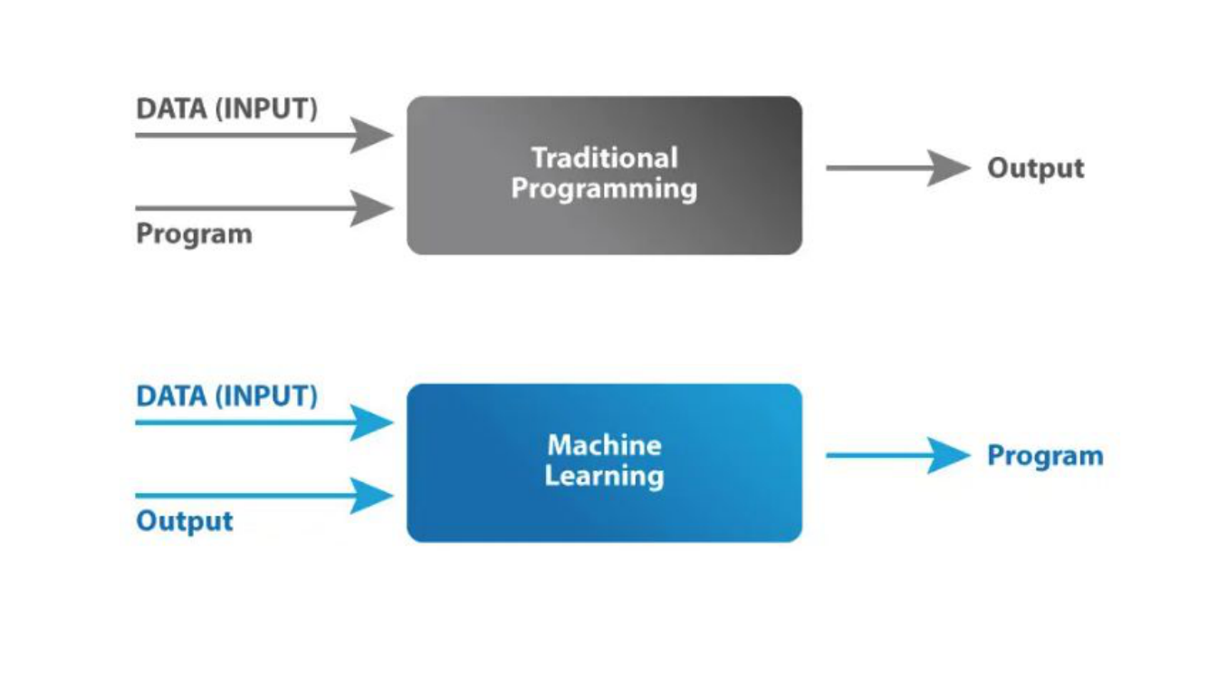
14

Slide 16
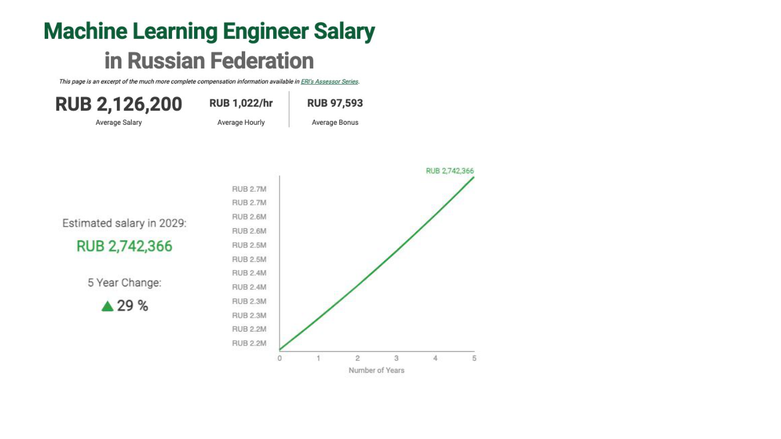
Job titles
• Machine Learning Engineer
• Data Scientist
• Research Scientist (Machine
Learning)
• Applied Machine Learning
Scientist
• Machine Learning Analyst
• Lead Machine Learning
Scientist
• Director of Machine Learning
• Chief AI Oﬃcer
Historical example from the source lecture (2025)
15

Slide 17

Applications of machine learning
Healthcare
Finance
E-commerce
Manufacturing
Transport and
Logistics
16

Slide 18
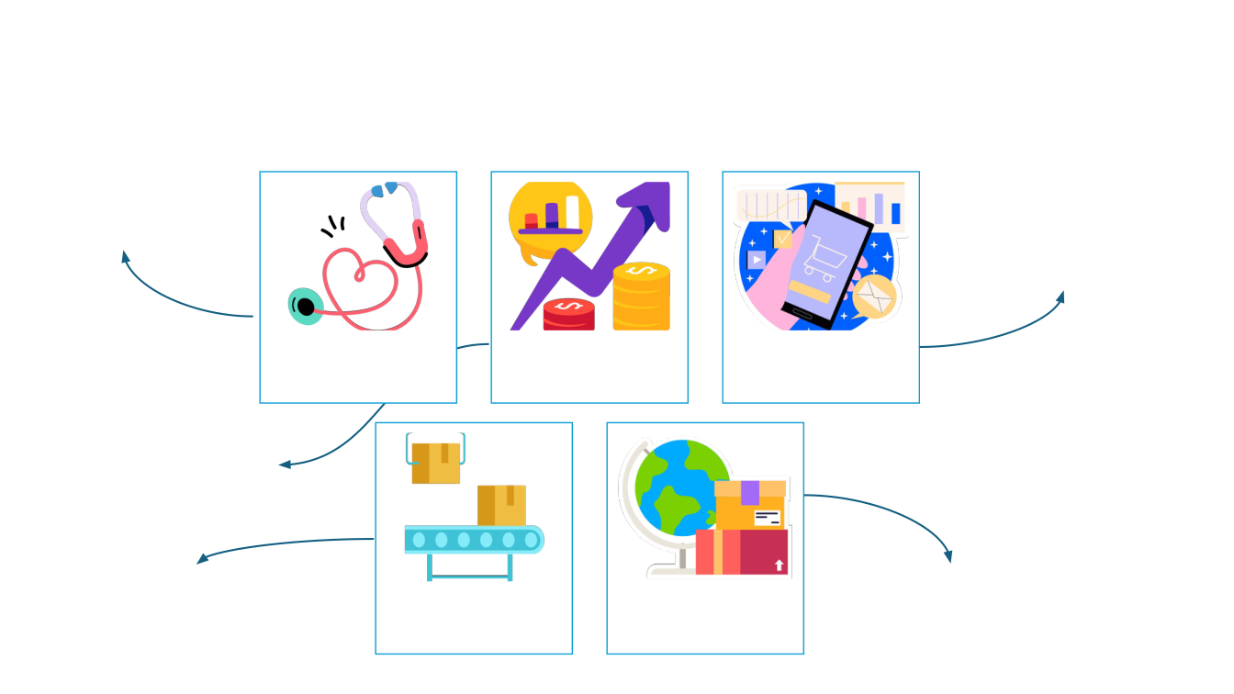
Applications of machine learning
- Diagnostics
- Predictive Analytics
- Personalized Medicine
- Recommendation Engines
- Customer Segmentation
- Inventory Management
Healthcare
Finance
E-commerce
- Fraud Detection
- Credit Scoring
- Algorithmic Trading
- Predictive Maintenance
- Route Optimization
- Quality Control
Manufacturing
Transport and
- Traﬃc Prediction
- Supply Chain Optimization
Logistics
17

Slide 19

Which ML applications
interest you?
Each student: suggest an idea for using ML to solve a
problem. Just raw ideas, do not think too much about
feasibility.
18

Slide 20
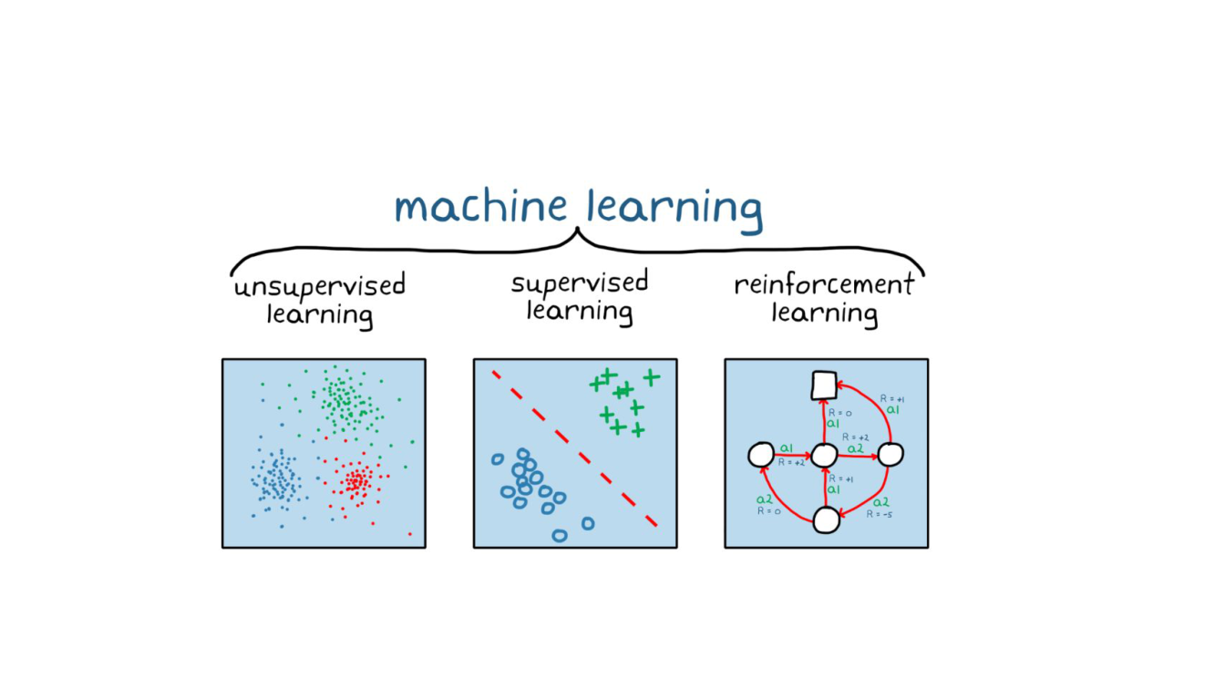
Types of machine learning
Unlabeled data
Find hidden structure
Labeled examples
Predict values or classes
Actions and rewards
Learn a decision policy
19

Slide 21
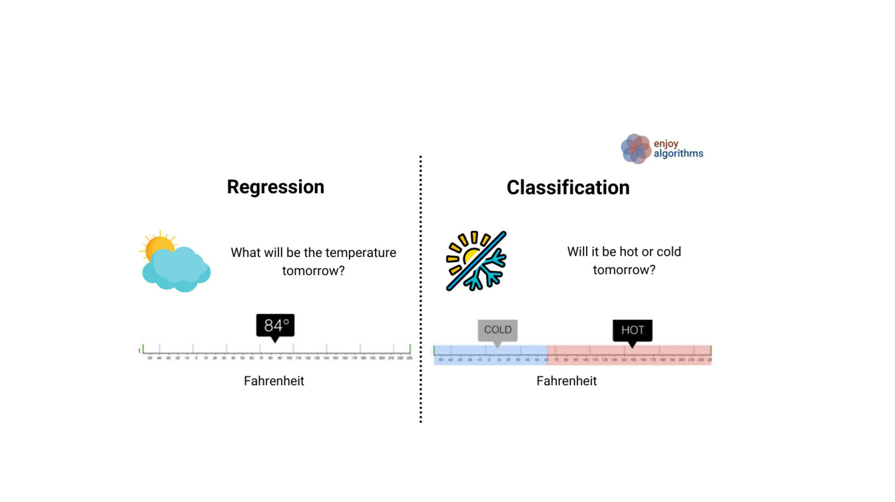
Types of Supervised Learning
Binary/
Multi-class
20

Slide 22
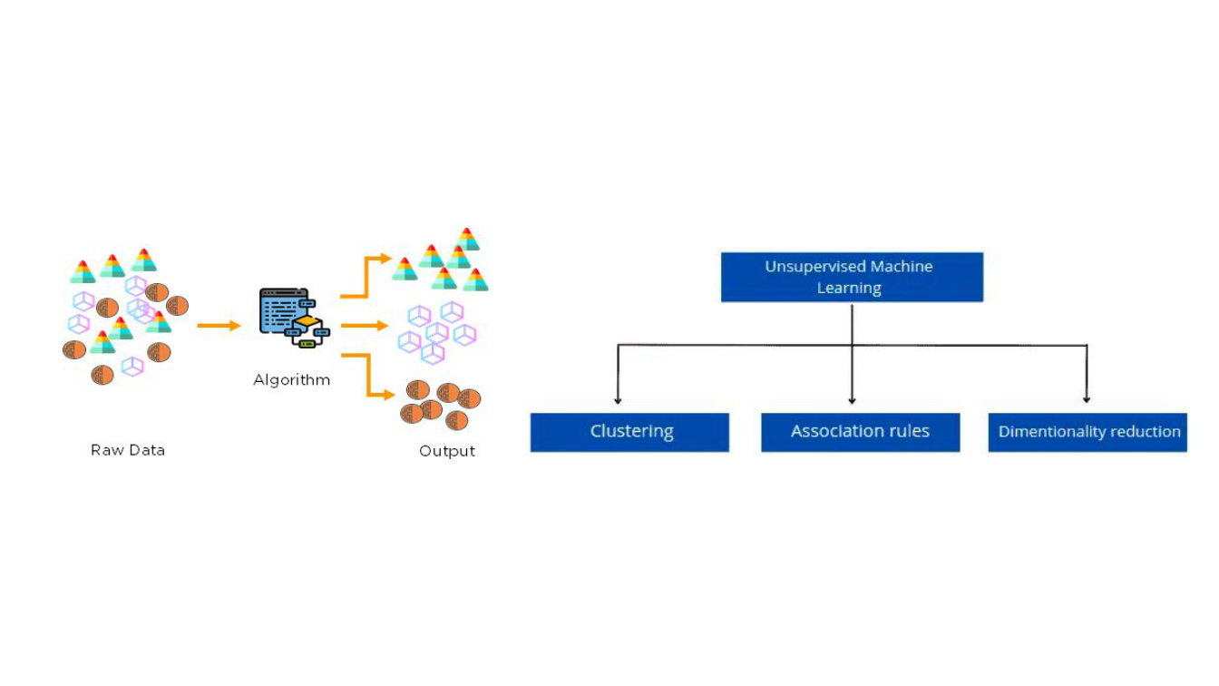
Types of Unsupervised Learning
21

Slide 23

What type of ML problem
do you think it is?
Scenario 1: A bank wants to predict whether a new
applicant will default on a loan. They have data on
previous applicants, including income, credit score, and
past financial behavior.
Question: What type of machine learning problem is
this, and why?
22

Slide 24
What type of ML problem
do you think it is?
Scenario 2: An e-commerce company wants to group its
customers into different segments to better tailor its
marketing strategy. They have information on customer
behavior, such as purchase frequency, spending habits,
and browsing history, but they do not know which
customer belongs to which group.
Question: What type of machine learning problem is
this, and why?
23

Slide 25
What type of ML problem
do you think it is?
Scenario 3: A robotic vacuum learns which actions to take while cleaning a house. It receives positive rewards for cleaning new areas and penalties for collisions or running out of battery.
The robot learns a policy to maximize its total reward over time.
Question: What type of machine learning problem is this, and why?
24

Slide 26
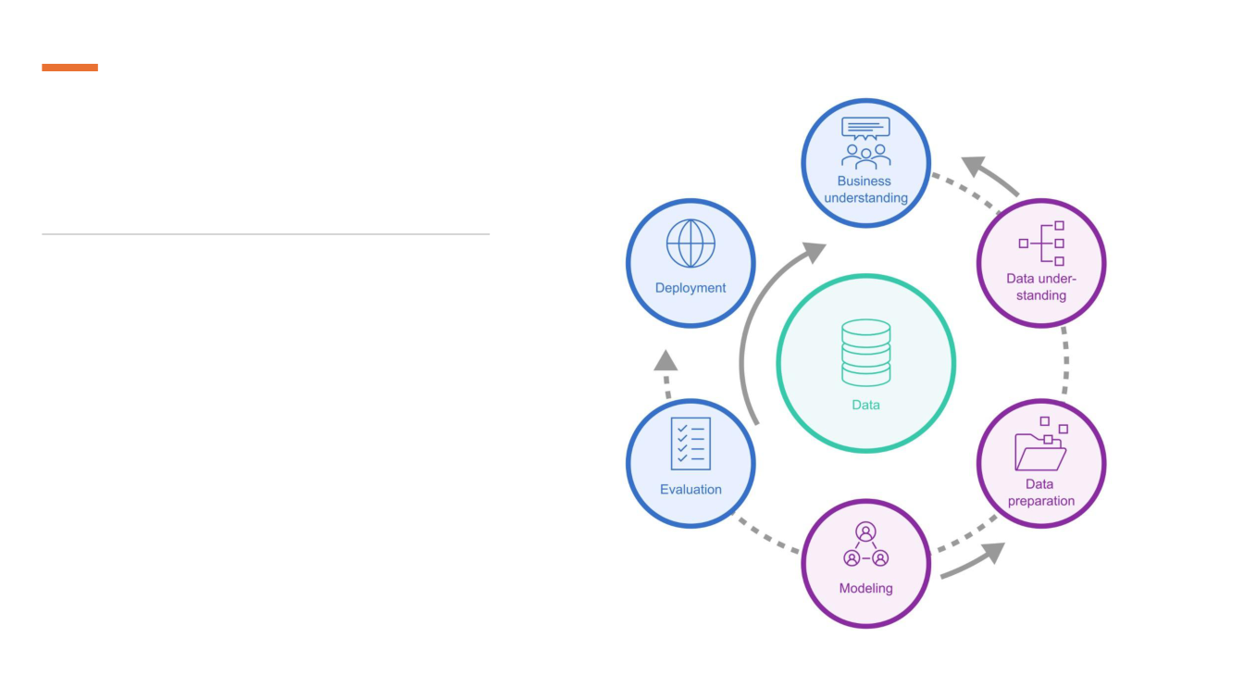
Machine learning
pipeline
Cross-Industry Standard Process for Data
Mining (CRISP-DM)
25

Slide 27
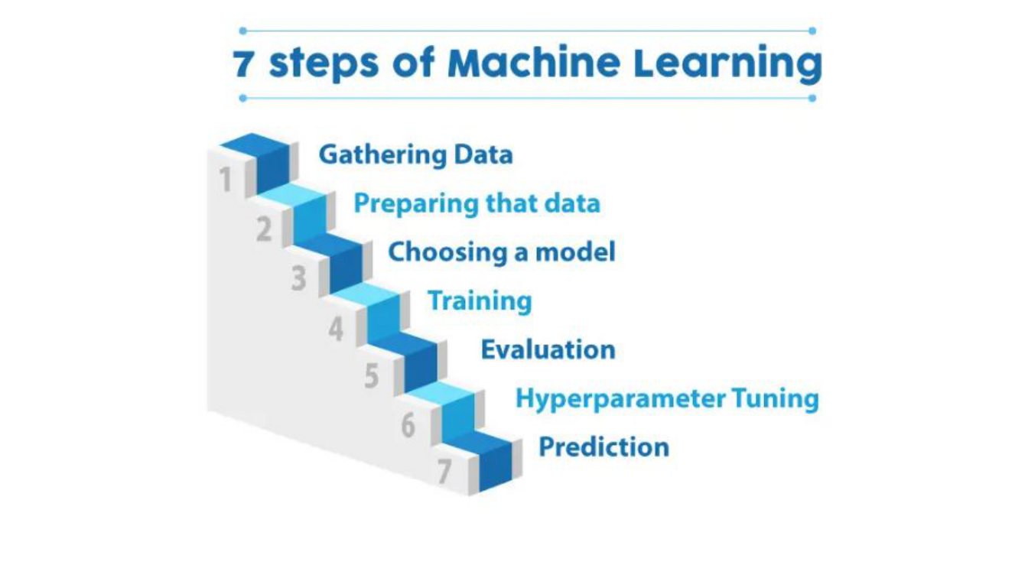
26

Slide 28
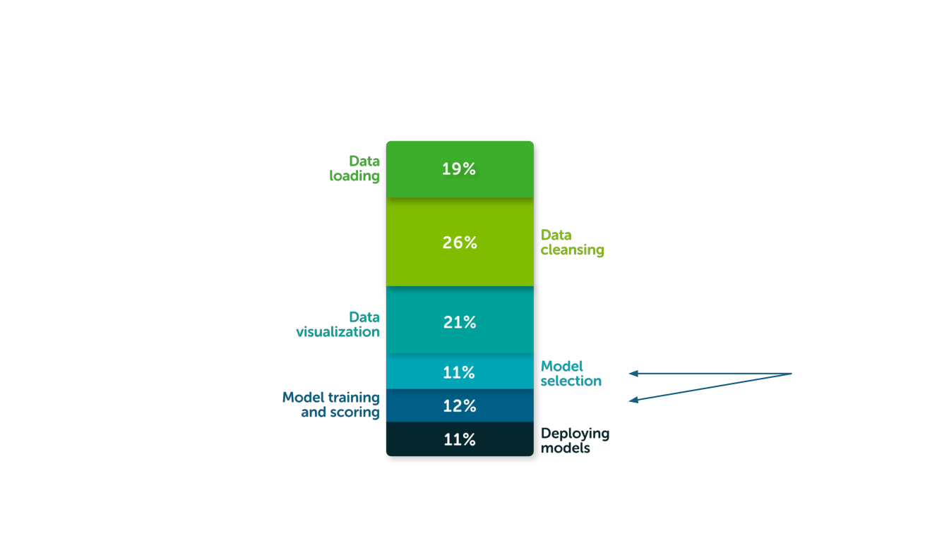
Time allocation for ML tasks
Focus of
this course
27

Slide 29

Some
practical
Underfitting vs Overfitting
Training, validation, and test dataset
splitting
Cross-validation
Hyperparameter tuning
aspects
Ensemble methods
28

Slide 30
Choosing the model
Example: predict daily electricity use from outdoor temperature.
One dot = one day
Cold days need heating.
Hot days need cooling.
What should we fit?
A straight line?
A smooth curve?
A very flexible curve?
29

Slide 31
Underfitting: missing the pattern
The same days, fitted with a straight line (a degree-1 polynomial).
A straight line
It misses the rise in use
on both cold and hot days.
High bias
The model is too simple
for this relationship.
Observed days
Underlying pattern
Fitted model
30

Slide 32
Overfitting: following the noise
The same days, fitted with a very flexible degree-12 polynomial.
Fits the training days
Sharp swings between
points can produce
unrealistic predictions.
Training RMSE: 1.7
Validation RMSE: 24.5
Observed days
Underlying pattern
Fitted model
A lower training error does not guarantee better predictions on unseen days.
31
Notes:
Synthetic teaching example. Daily building electricity use versus outdoor temperature. True mean = 24 + 0.22*(temperature - 16)^2. Gaussian day-to-day variation with standard deviation 4 kWh. Fixed stratified training temperatures; independent observations in each sample. A separate 400-day synthetic validation set is shared across model comparisons. These values do not describe a measured building. This slide uses the exact same 14 observed days as the immediately preceding underfitting slide. A degree-12 polynomial has training RMSE 1.666319 kWh/day and validation RMSE 24.497968 kWh/day on the same 400 independent simulated validation days. The negative predictions are an unrealistic consequence of the overly flexible polynomial, not negative measured electricity consumption. The following quadratic example has validation RMSE 3.674166 kWh/day. RMSE is root mean squared prediction error. Lower is better.

Slide 33
A quadratic curve captures the pattern
The same days, fitted with a degree-2 polynomial.
A smooth U-shaped curve
Follows the main pattern.
Daily variation remains
around the fitted curve.
Check unseen days
Validation RMSE:
3.7 kWh/day
Observed days
Underlying pattern
Fitted model
32

Slide 34
High variance: an unstable model
Observed days
Underlying pattern
Fitted model
Sample A
Sample B
Sample C
At 24°C, predictions range from 27.2 to 47.6 kWh/day.
High variance means predictions change a lot when the training sample changes.
33

Slide 35
High bias: a model that misses the pattern
Observed days
Underlying pattern
Fitted model
Sample A
Sample B
Sample C
At 16°C, the line models average 42.2 kWh/day. The true mean is 24.0.
High bias is a systematic miss, averaged across different training samples.
34

Slide 36
Bias and variance: choose with validation
Compare model complexity using predictions on unseen days.
Lowest validation error
Degree 2
3.7 kWh/day
Too simple: misses the pattern.
Too flexible: starts fitting noise.
Choose with validation data.
Training error
Validation error
Selected model
RMSE measures prediction error in kWh/day. Lower is better.
35

Slide 37
Overﬁtting and Underﬁtting
Underfitting
A model is too simple to capture useful patterns. It performs poorly even on the training data and often has high bias.
Overfitting
A model fits training-specific noise or details. Training performance is strong, but performance on unseen data is worse. High variance is a common symptom.
36

Slide 38
Exercise
Scenario 4: A model predicts apartment prices using only size. It consistently misses the higher prices of apartments near the metro, including in the training data.
Question: Does this suggest high bias or high variance?
Scenario 5: A highly flexible model predicts exam scores using study hours, attendance, and many irrelevant features. It fits the training class almost perfectly, but performs poorly on a new class.
Question: Does this suggest high bias or high variance?
37

Slide 39
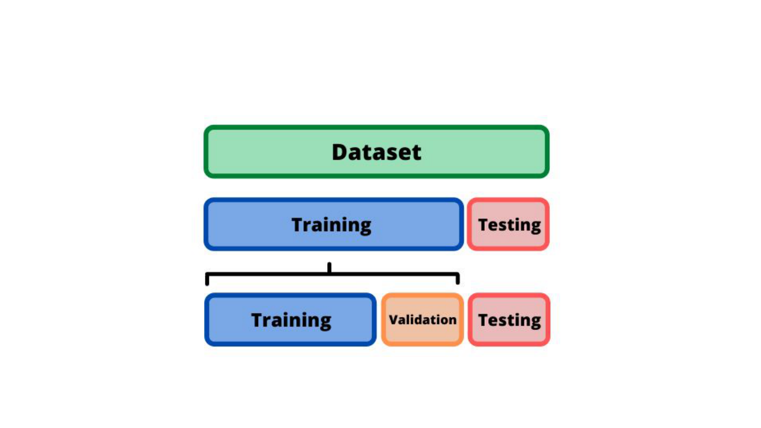
Dataset splitting
Training: fit the model. Validation: select settings. Test: evaluate the final model.
38

Slide 40
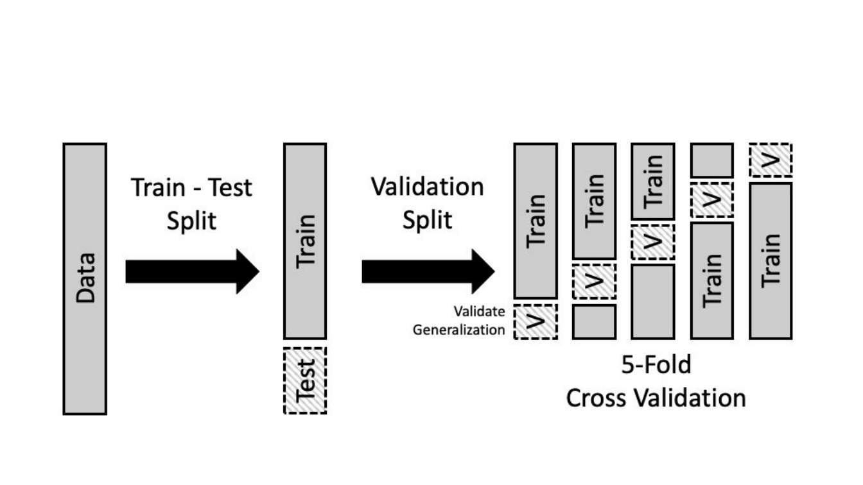
Cross Validation
Tune within the training data using CV. Keep the final test set untouched.
39

Slide 41

Practice
Sources to learn Machine Learning
Lab work
39

Slide 42
Sources to learn ML
Scikit-learn documentation
https://scikit-learn.org/stable/
Kaggle
https://www.kaggle.com/
Machine Learning Mastery
https://machinelearningmastery.com/
Machine learning books
https://github.com/josephmisiti/awesome-machine-learning/blob/master/books.md

Slide 43
Practice
Quiz
Lab 01 (required)
https://github.com/Ahsan-ShakoorK/NSU_ML/blob/2026-course/nbs/lab01.ipynb
Pandas exercises
https://github.com/datasciencelab-ai/100_bai_tap_pandas

Slide 44
References
Machine learning in healthcare
https://acropolium.com/blog/machine-learning-in-healthcare-use-cases-benefits-and-success-stories/
Classification and regression
https://www.enjoyalgorithms.com/blogs/classification-and-regression-in-machine-learning
Unsupervised learning guide
https://hands-on.cloud/ml-unsupervised-learning-guide/
Introduction to unsupervised learning
https://medium.com/analytics-vidhya/beginners-guide-to-unsupervised-learning-76a575c4e942
ML engineer salary: original historical source
https://www.erieri.com/salary/job/machine-learning-engineer/russian-federation
Machine learning job titles
https://www.tealhq.com/job-titles/machine-learning-scientist
Cross-validation
https://learningds.org/ch/16/ms_cv.html

